Slide 1
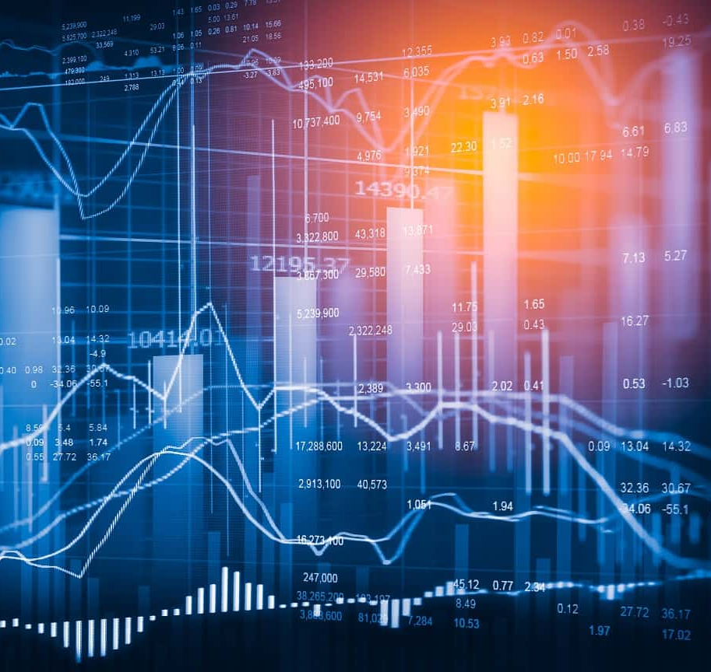
Stock Market Analysis
Team Members:
Mohamed Elhelow
Christopher Michos

Slide 2
Project Overview
This project is focused on identifying how news sentiment/events affect the stock market. and how COVID-2019 has affected the stock market.
Our Objectives include
Influence of specific news events on market fluctuation (Covid-19, Russian Invasion of Ukraine).
Analyzing the correlation between news sentiment and the VIX (Volatility Index).
Impact on different indices (S&P 500, NASDAQ, Dow Jones) This allows us to gain general market sentiment in the tech sector and industrial sector).

Slide 3
Data Sources
Obtained through API/web scraping
S&P 500 Index Data: Historical closing prices and volume data.
VIX Data: Corresponding historical values for volatility assessment.
NASDAQ: Additional data for a market comparison. (Tech)
Dow Jones: Additional data for a market comparison. (Industrial)
News event timelines (Covid-19, Russian Invasion of Ukraine): Comparative Analysis pre/post-covid, lockdown announcements and the announcement of the Russian incursion into Ukraine.
News Sentiment – By Federal Reserve Bank of San Francisco Economic Research

Slide 4
Data Collection
Collection Process
Historical opening and closing prices for the selected indices were collected from Yahoo Finance using API web scraping as a csv file.
VIX (Volatility Index) Opening and closing prices collected from Yahoo Finance using API web scraping as a csv file.
A catalogue of covid-19 related news events established for analysis.
The announcement of the Russia's "Special Military Operation" on February 24, 2022, was collected through reading news articles.
Challenges and Insights:
Consistency across different sources is essential which is why we collected all our data through web scraping Yahoo Finance.
Stock splits and dividends were not accounted for in this analysis due to added layer of complexity and the project’s news sentiment market trend focus.
Dow Jones had restrictions on downloading historical data, so we had to resort to API/Web scraping.
We could not access the data for the Dow Jones after 2022 due to yfinance’s limitations.
We also had an issue with directly downloading from yahoo finance as there was missing data, so in the end, we had to API/web scrape all the data

Slide 5
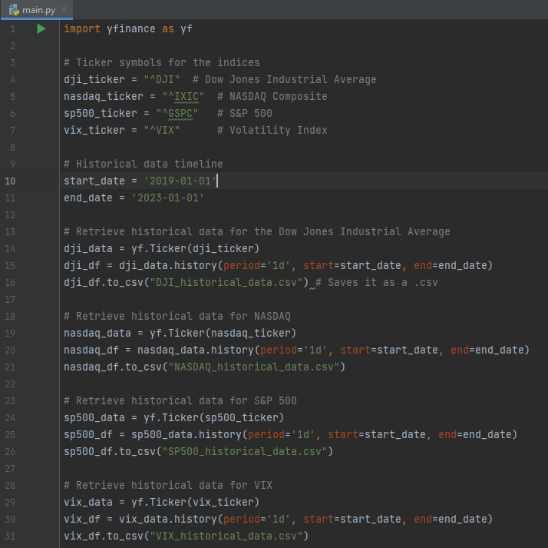
API/Web Scraping
The Dow Jones index does not allow you to download their historical data, so yahoo finance has turned off the ability to download CSVs off for the Dow Jones.
To get around this restriction, we had to do a pip install for the yfinance module on command prompt which is an unofficial python library.
Then we had to run the code on the right side to scrape the data off yfinance.
We also had to scrape the rest of the data afterwards, as directly downloading from yahoo finance gave us missing data.

Slide 6

Data Preparation
Data Review
Verified data integrity: Ensuring there were no errors when downloading the .csv file
Standardized format: All data sources have the same timelines and data types across all the csv files.
Data Normalization
Normalizing the data: movements are rescaled to a comparative range
Base close: Initial value of each on 2019, 1, 2
Indexed value: calculates percentage change of each index from base value.
Feature Engineering
Time feature: Extracted year, quarter, month, week, and day
Movement indicators:
Extracted daily percentage changes for indices for short term analysis
Rolling Averages for longer term analysis

Slide 7
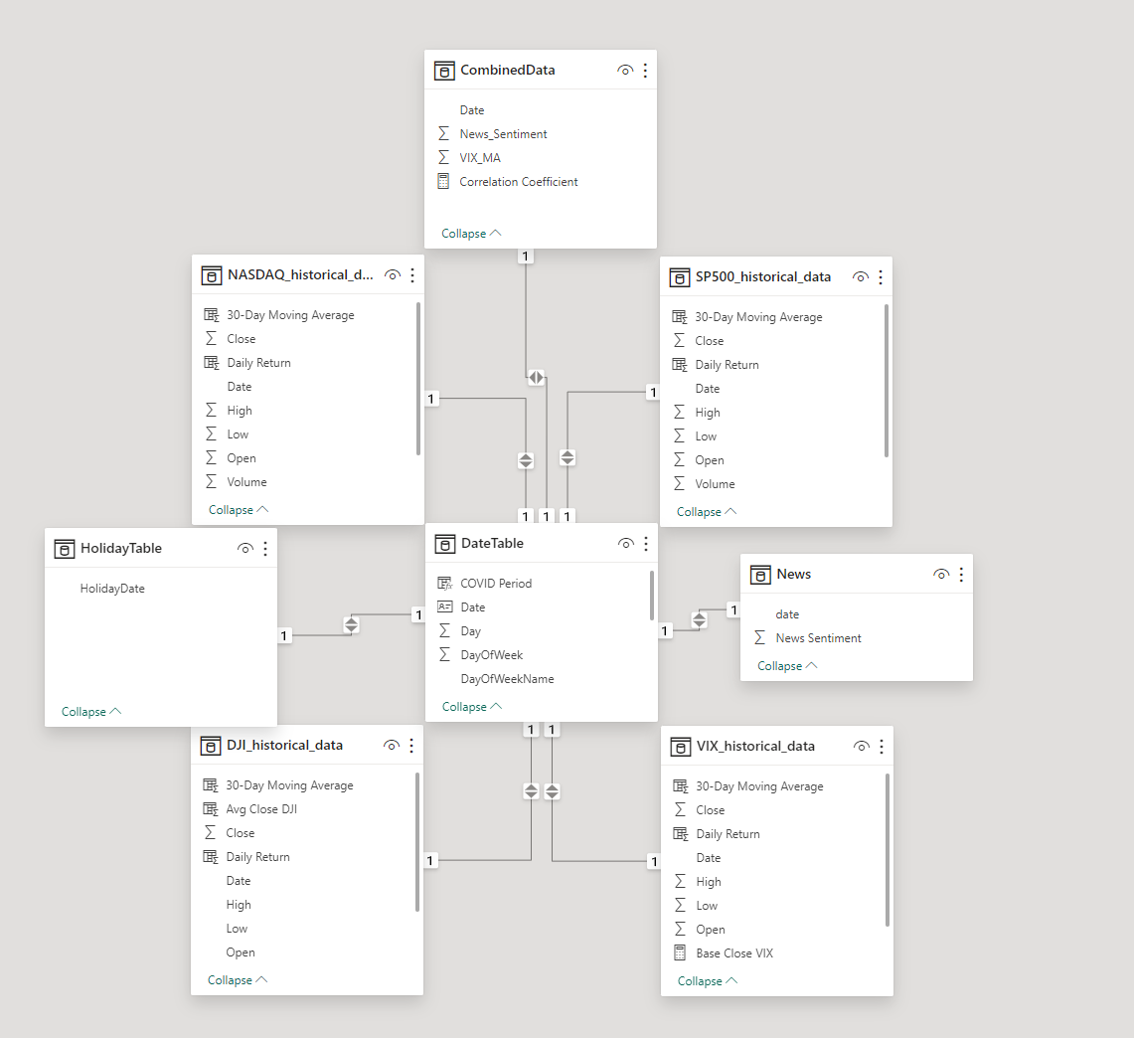
Data Modelling
PowerBI is being utilized for our data modeling and data visualizations
We decided to use PowerBI due to its visualization options and interactive reports
Challenges faced during the data modelling phase.
For a date hierarchy of a day, month, quarter and year. A DAX formula had to be created for the table.
Filtering out non-trading days.

Slide 8
Data Exploration
Impact of News on Indices: Observed distinct reactions of different indices to the same news events, highlighting sector sensitivities.
Discovered findings
High correlation between news sentiment and volatility.
Large volumes of trade during COVID-19 news events.
Sector contribution percentage change after COVID-19.

Slide 9
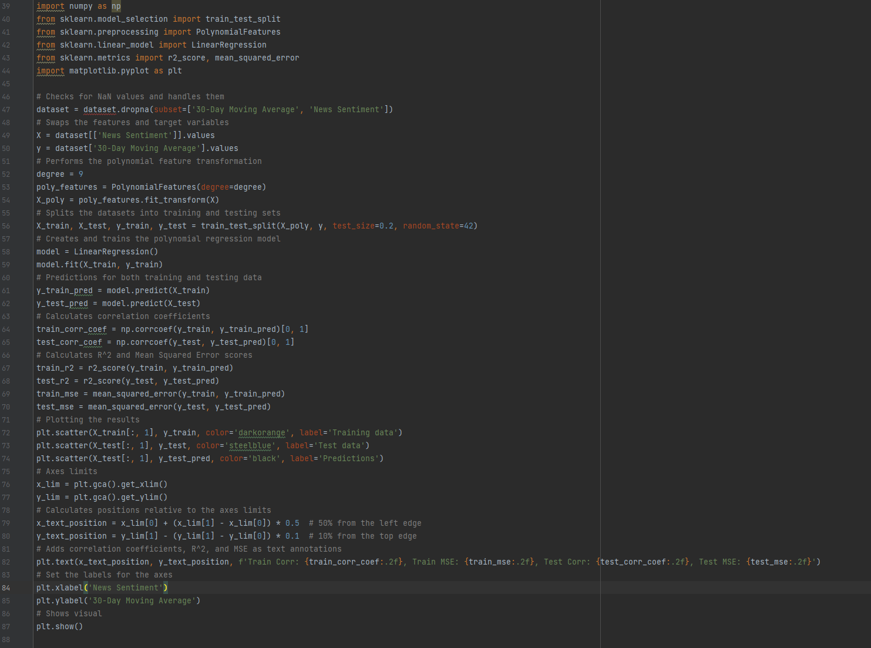
Polynomial Regression
4
Code used to create the Polynomial regression model for non-linear relationship.
Using the degrees we raised each feature to the 2nd, 3rd, and 4th power to uncover hidden relationships.
(Ex. Extreme news sentiment acts differently to moderate sentiment.)
This also created interactions between all degrees of features for the model to gain an understanding of if there's a combined effect of the two features.

Slide 10
Visualization Techniques
Chosen visualization techniques
Line Charts: Used to display trends and movements over time.
Bar Charts: Employed to show comparative performances.
Scatter Plot: Used to represent the correlation between news sentiment and trade volatility.
Heat Map: Used to show the trade volume change during important news events.
Pie Chart: Used to show contribution percentage change
Rationale behind each choice
Line Charts: Offer a clear view of price trends and are easily understood by a broad audience.
Bar Charts: Provide a straightforward method for comparing different data points, such as the performance of various sectors.
Scatter Plot: Show the effects of news on the volatility of trade, which shows how much pressure news has on stock trading.
Text box contains timeline of important news events for the data set.
Heat map: Shows a visual impact of news events on the volume of trade.
Pie Chart: Visualize the sector contribution changes.

Slide 11
Questions
What was the influence of news events on market volatility? What kind of correlation is there between news sentiment and the trading volatility? Does negative news sentiment increase or decrease the volatility of trade?
What do trade volumes look like in reaction to news events?
How has sector contribution changed post COVID-19

Slide 12
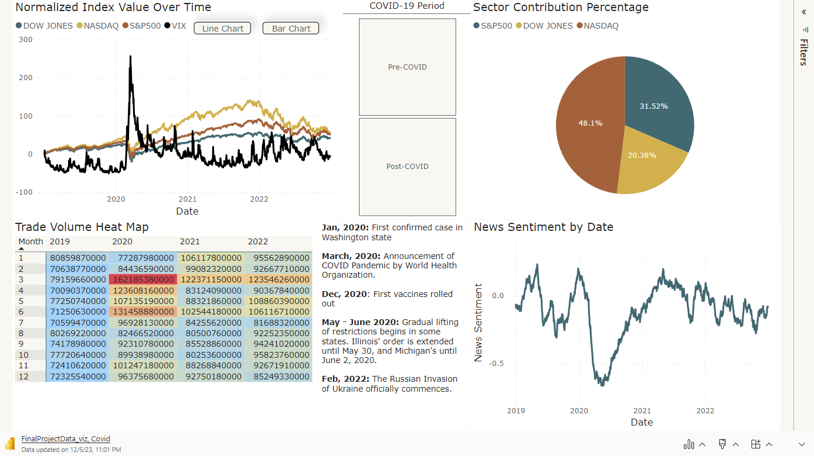

Slide 13
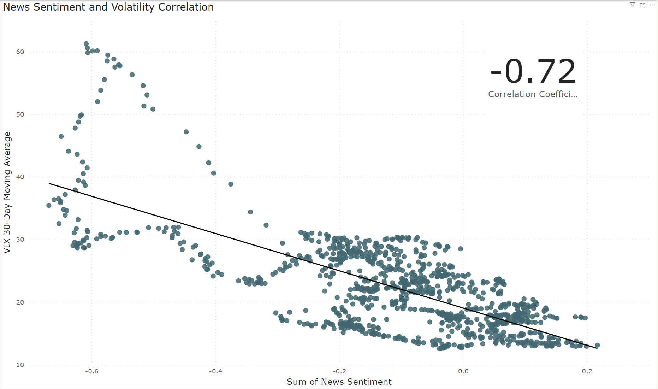

Slide 14
